Slide 1
Chapter Sixteen
Securities Firms and Investment Banks
©McGraw Hill LLC. All rights reserved. No reproduction or distribution without the prior written consent of McGraw Hill.

Slide 2
Services Offered by Securities Firms Versus Investment Banks
Securities firms and investment banks help net suppliers of funds (e.g., households) transfer funds to net users of funds (e.g., businesses) at a low cost and with a maximum degree of efficiency
Investment banking involves transactions such as the raising of debt and equity securities for corporations or governments
  Includes the origination, underwriting, and placement of securities in money and capital markets for corporate or government issuers, as well as corporate finance activities (e.g., advising on mergers and acquisitions (M&As) and the restructuring of existing corporations)
  Investment banks specialize in origination, underwriting, and distributing issues of new securities (commercial side of the business)
Securities services involve assistance in the trading of securities in the secondary markets (brokerage services or market trading)
  Securities firms specialize in the purchase, sale, and brokerage of existing securities (retail side of the business)
Notes:
2

Slide 3
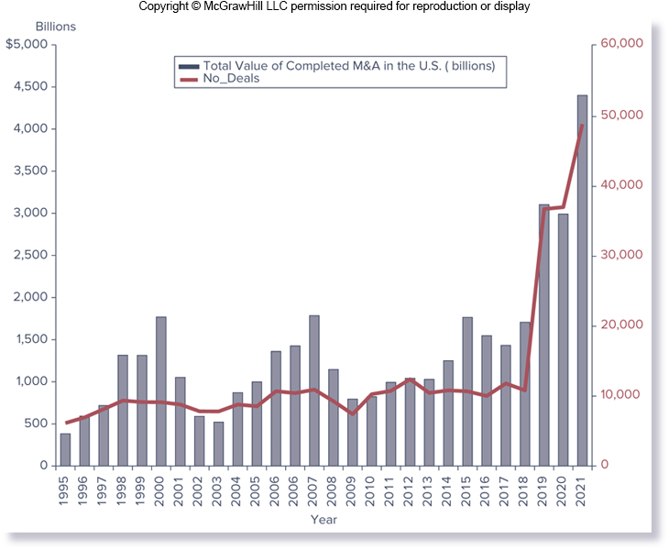
Total Value of U.S. Mergers and Acquisitions Managed by Investment Banks, 1995-2021
Notes:
3
Figure 16–1 reports M&As managed by investment banks for the period 1995-2021. Total dollar volume (measured by completed merger transaction value) of domestic M&As increased from less than $200 billion in 1990 to $1.83 trillion in 2000.

Slide 4
Size, Structure and Composition of the Industry
Size of the industry is usually measured by the equity capital of firms participating in the industry rather than by “asset size”
  Equity capital in the NYSE reporting broker-dealers amounted to $239 billion in 2021
Number of firms in the industry changed dramatically over time, with the major cause being regulatory changes (e.g., Financial Service Modernization Act of 1999)
  5,248 firms in 1980
  9,515 firms in 1987
  5,052 firms in 2006
  3,794 firms in 2021
Investment banking industry was irrevocably changed as a result of the financial crisis
  Five largest investment banks at the beginning of 2008 were all gone as investment banks by the end of the year
Notes:
4

Slide 5
Subgroups of Industry Firms
Firms in the industry can be divided along several dimensions:
  Largest firms are diversified financial service (or national full-service) investment banks that service both retail and corporate customers
    Assist retail customers by acting as broker-dealers
    Assist corporate customers by securities underwriting
National full-service firms fall into three subgroups:
  Commercial banks (or financial services holding companies) are the largest of the full-service investment banks (e.g., JPMorgan) and have extensive domestic and international operations
  National full-service firms specialize more in corporate finance or primary market activities and are highly active in trading securities, or secondary market activities (e.g., Goldman Sachs)
  Large investment banks maintain more limited branch networks concentrated in major cities operating with predominantly institutional client bases (e.g., Greenhill & Co.)
Notes:
5

Slide 6
Subgroups of Industry Firms (Continued)
Remainder of industry is comprised of firms that perform a mix of primary and secondary market services for a particular segment of the financial markets:
  Regional securities firms
    E.g., Raymond James Financial
  Specialized discount brokers
    E.g., Charles Schwab
  Specialized electronic trading securities firms
    E.g., E*Trade
  Venture capital and private equity firms
  Other firms include research boutiques, companies with large clearing operations, and other firms that do not fit into one of the categories above
Notes:
6

Slide 7
Investment Banking
Investment banking refers to activities related to underwriting and distributing new issues of debt and equity securities
  New issues can be either first-time issues of a company’s debt or equity securities or the new issues of a firm whose debt or equity is already trading (i.e., seasoned issues)
$11.47 trillion of debt and equity was underwritten globally in 2021
Securities underwriting can be undertaken through either public or private offerings
  Public offering represents the sale of a security to the public at large
    Securities may be underwritten on a best efforts or a firm commitment basis
  In a private offering, an investment bank acts as a private placement agent for a fee, placing the securities with one or a few large institutional investors (e.g., life insurance companies)
Investment bank may also participate as an underwriter in government, municipal, and mortgage-backed securities
Notes:
7
Securities firms and investment banks engage in as many as eight key activity areas: investment banking, venture capital, market making, trading, investing, cash management, mergers and acquisitions, and other service functions.
With best efforts underwriting, investment bankers act as agents on a fee basis related to their success in placing the issue with investors. In firm commitment underwriting, the investment bank acts as a principal, purchasing the securities from the issuer at one price and seeking to place them with public investors at a slightly higher price.

Slide 8
Venture Capital
Difficulty for new and small firms in obtaining debt financing from CBs is that CBs are generally not willing to make loans to new companies with no assets or business history
Venture capital (VC) is a professionally managed pool of money used to finance new and often high-risk firms
  Generally provided to back an untried company and its managers in return for an equity investment in the firm
  VC firms are not generally passive investors; they provide valuable expertise to the firm’s managers and may help with recruiting
  Many different types of VC firms:
    Institutional VC firms are business entities whose sole purpose is to find and fund the most promising new firms
      Include limited partner VC firms, financial VC firms, and corporate VC firms
    Angels are wealthy individuals who make equity investments
Notes:
8

Slide 9
Venture Capital vs. Private Equity
VC and private equity (PE) are often used interchangeably, but there are distinct differences in the two types of investments:
  VC firms concern themselves more with startup business concerns
  VC firms tend to utilize teams of either scientific or business professionals to help identify new and emerging technologies in which to place their money
  PE firms deal more with existing companies that have already proven themselves in the business field
As a result of the financial crisis, the differences between VC and PE firms have become less distinct
  Fewer new ventures being brought forth means greater competition between VC and PE firms
Notes:
9

Slide 10
Market Making
Market making involves the creation of a secondary market in an asset by a securities firm or investment bank
Market making can involve either agency or principal transactions:
  Agency transactions are two-way transactions made on behalf of customers
  In principal transactions, the market maker seeks to profit on the price movements of securities and takes either long or short inventory positions for its own account
Designated market makers (DMMs) provide liquidity in a given NYSE security by assuming risk and displaying quotes in the exchange limit order book
  Accounted for about 17% of liquidity adding volume in NYSE-listed securities in 2019
Notes:
10

Slide 11
Trading
Trading is closely related to market-making; a trader takes an active net position in an underlying instrument or asset
There are at least six types of trading activities:
  Position trading involves purchases of large blocks of securities on the expectation of a favorable price move
  Pure arbitrage involves buying an asset in one market at one price and selling it immediately in another market at a higher price
  Risk arbitrage involves buying securities in anticipation of some information release (e.g., merger or takeover announcement)
  Program trading is the simultaneous buying and selling of a portfolio of at least 15 different stocks valued at more than $1 million, using computer programs to initiate such trades
  Stock brokerage involves trading securities on behalf of customers
  Electronic brokerage involves direct assess, via the Internet, to the trading floor, therefore bypassing traditional brokers
Notes:
11

Slide 12
Investing and Cash Management
Investing involves managing pools of assets such as closed- and open-end mutual funds
  Securities firms can manage such funds either as agents for other investors or as principals for themselves and their stockholders
  Objective in funds management is to select asset portfolios to beat some return-risk performance benchmark, such as the S&P 500 Index
Securities firms and investment banks offer bank deposit-like cash management accounts (CMAs), money market mutual funds that offer checkwriting privileges
  Can be covered directly or indirectly by federal deposit insurance from the FDIC
Notes:
12

Slide 13
Mergers and Acquisitions
Investment banks frequently provide advice on, and assistance in, mergers and acquisitions
  Assist in finding merger partners
  Underwrite any new securities to be issued by the merged firms
  Assess the value of target firms
  Recommend terms of the merger agreement
  Assist target firms in preventing a merger
Notes:
13

Slide 14
Other Service Functions
Other service functions include the following:
  Custody and escrow services
  Clearance and settlement services
  Research and advisory services
In performing these functions, investment banks normally act as agents for a fee
  Fees charged are often based on the total bundle of services performed for the client by the firm
  Portion of the fee or commission allocated to research and advisory services is called soft dollars
IBs are making increasing inroads into traditional bank service areas, such as small-business lending and the trading of loans
Notes:
14

Slide 15
Recent Trends
Industry trends depend heavily on the state of the stock market and the economy
  Commission income fell after the 1987 stock market crash
  Record stock market trading volumes between 1992 through 2000 resulted in a recovery in commission income
  Improvements in the U.S. economy in the mid-2000s led to even greater increases in commission income, but income fell with the stock market in 2006-2008, due to rising oil prices and the subprime mortgage collapse
  Commission income again rose in the early and mid-2010s, as the economy and the stock market recovered, but it started declining again in late 2010s
Notes:
15

Slide 16
Recent Trends (Continued)
By the mid-2010s, while the industry had put most problems from the financial crisis behind it, the industry was affected by post-crisis consequences, with increased regulation on risk taking and capital requirements
  Result of new regulations is that profitability is down: pretax profits in 2013, 2014, and 2015 fell to $26.3b, $27.0b, and $23.8b, respectively. In 2016 through 2021, the pretax profits rose because revenues grew faster than expenses.
Since 2013, many companies have taken strategic initiatives to respond to new regulations and de-risk their firms
  Led to balance sheet reductions, as well as downsizing or disposition of select businesses, trading products, and investments
  Corporate strategies increasingly focus on client services and away from making large bets through principal investments
Notes:
16

Slide 17
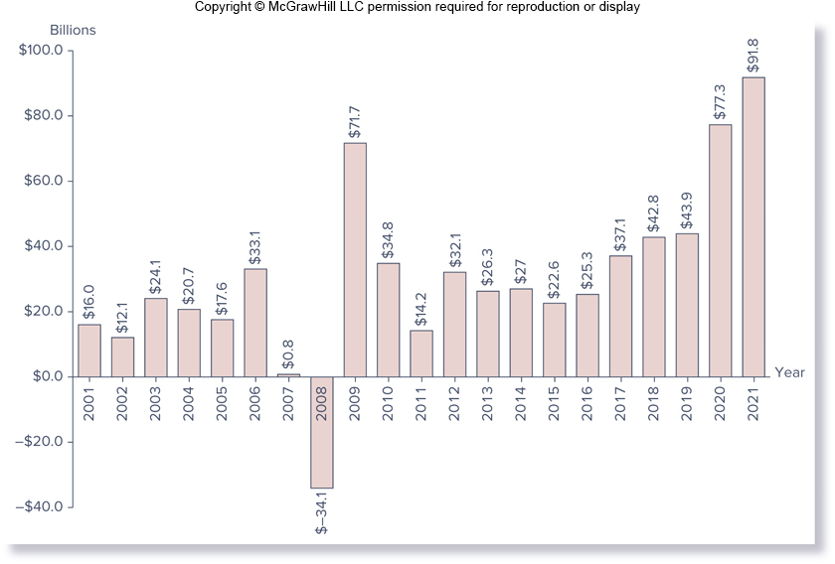
Securities Industry Pretax Profits, in billions of dollars, 2001 - 2021
Notes:
17
16-3

Slide 18
Balance Sheets
Assets
  Many of the assets appearing on the balance sheet of securities firms are cash like money market instruments, not capital market positions
  Receivables from other broker-dealers and clearing organizations accounted for 30.7% of total assets
  Reverse repurchase agreements accounted for 28.7% of assets
  Long positions in securities accounted for 13.3% of assets
Notes:
18

Slide 19
Balance Sheets (Continued)
Liabilities
  Major similarity between securities firms and all other types of FIs is a high degree of financial leverage (i.e., all these firms hold high levels of debt)
  Difference in the funding is that securities firms tend to use liabilities that are extremely short-term and market-based
  Repurchase agreements were the major source of funds, amounting to 35.9% of total liabilities and equity
  Other major sources of funds were loans (27.0%), and payables owed to other broker-dealers and clearing organizations(15.0%),
Equity
  Equity capital amounted to only 6.8% of total assets
Notes:
19

Slide 20
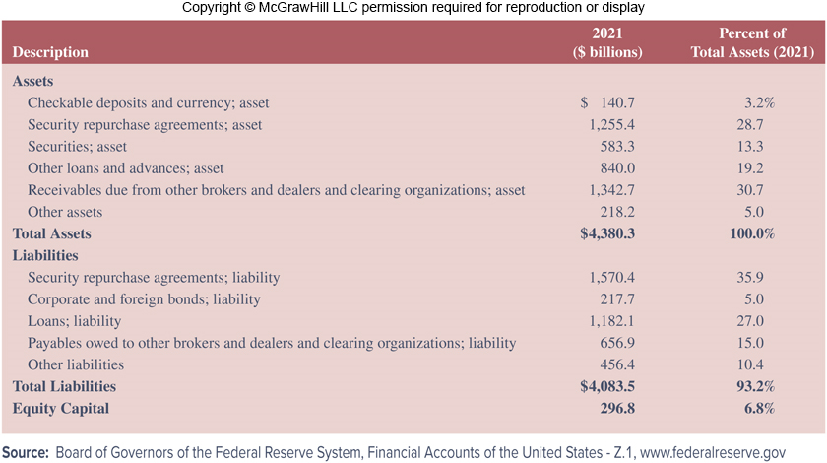
Assets and Liabilities of Broker-Dealers, in billions of dollars, 2021
Notes:
20
The consolidated balance sheet for the industry is shown in Table 16–7.

Slide 21
Regulation
Securities and Exchange Commission (SEC) is the primary regulator of the securities industry
  Established in 1934 largely in response to abuses by securities firms that many at the time felt were partly responsible for the economic problems in the U.S.
  Primary role of SEC includes administration of securities laws, review and evaluation of registrations of new securities offerings, review and evaluation of annual and semiannual reports summarizing the financial status of all publicly held corporations, and the prohibition of any form of security market manipulation
National Securities Markets Improvement Act (NSMIA) of 1996 reaffirmed significance of SEC as primary regulator; states are not allowed to
  Require federally registered securities firms to be registered in a state
  Require registrations of securities firms’ transactions or impose substantive requirements on private placements
Notes:
21

Slide 22
Regulation (Continued)
While the SEC sets the overall regulatory standards for the industry, the Financial Industry Regulatory Authority (FINRA) is involved in the day-to-day regulation of trading practices
  FINRA is an independent, not-for-profit organization authorized by Congress
  FINRA writes and enforces rules governing the activities of securities firms, examines firms for compliance with those rules, works to foster market transparency, and supports investor education
  FINRA monitors trade abuses, trading rule violations, and securities firms’ capital (solvency positions)
  FINRA also performs market regulation under contract for the major U.S. stock exchanges
Wall Street Reform and Consumer Protection Act of 2010
Notes:
22

Slide 23
Regulation (Concluded)
U.S. Congress also oversees the industry
  U.S. Senate Permanent Subcommittee on Investigations was created with the broad mandate to determine whether any changes are required in U.S. law to better protect the public
  Spring of 2010
    Subcommittee hearing focused on the contributing role of investment banks (e.g., Goldman Sachs) in the financial crisis
    Subcommittee brought up evidence and internal Goldman documents that showed Goldman knew the housing market was on the brink of collapse but continued to sell mortgage-backed securities to investors
    Goldman allegedly bet against the securities it built and sold with the knowledge that the housing market’s collapse would bring the firm a sizable payday
Notes:
23
Investment banks such as Goldman Sachs bundled toxic mortgages into complex financial instruments, many of which were rated AAA by credit-rating agencies and sold them to investors.

Slide 24
Securities Investor Protection Corporation (SIPC)
Securities Investor Protection Corporation (SIPC) protects investors against losses of up to $500,000 on securities firm failures
  Not an agency or establishment of the U.S. government, and has no authority to investigate or regulate its member broker-dealers
  Created under the Securities Investor Protection Act of 1970 as a non-profit membership corporation
  Oversees the liquidation of member broker-dealers that close when the broker-dealer is bankrupt or in financial trouble and customer assets are missing
  Focus is on restoring customer cash and securities left in the hands of bankrupt of otherwise financially troubled brokerage firms
Notes:
24

Slide 25
Global Issues
Securities firms and investment banks are by far the most global of any group of financial institutions
  Both U.S. and European IBs compete for business worldwide
As domestic securities trading and underwriting grew in the 1990s and 2000s, so did foreign securities trading and underwriting
Result of the financial crisis in the late 2000s was that large investment banks around the world became more concerned than ever with capital, liquidity, and leverage; however, they did not want to lose ground in the global competition for clients
  Global IBs looked for strategic alliances that would allow them to compete in foreign markets, or they exited those markets altogether
One of the more grievous actions by some global IBs during the financial crisis was the manipulation of the LIBOR
Notes:
25
LIBOR is the average of the interest rates submitted by major banks in the United States, Europe, and the United Kingdom in a variety of major currencies such as the dollar, euro, and yen.

Slide 26
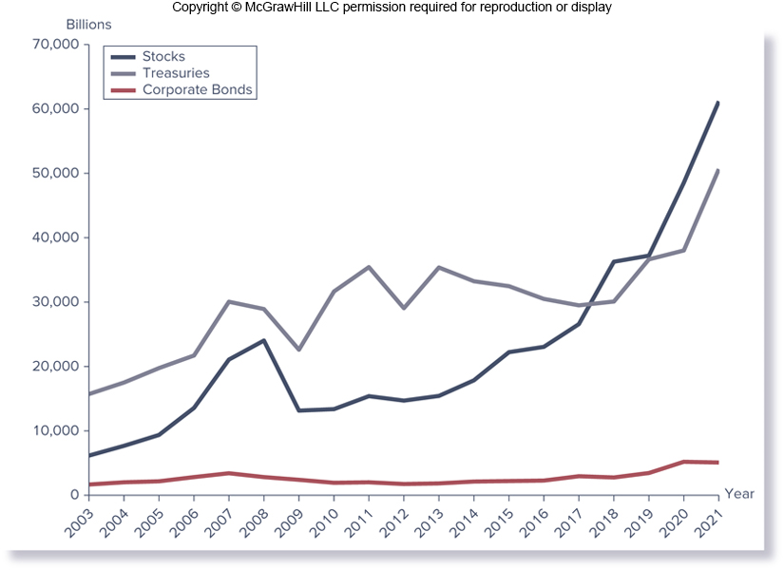
Foreign Transactions in U.S. Securities Markets
Notes:
26
Figures 16–4 shows the foreign transactions in U.S. securities from 2003 to 2021.

Slide 27
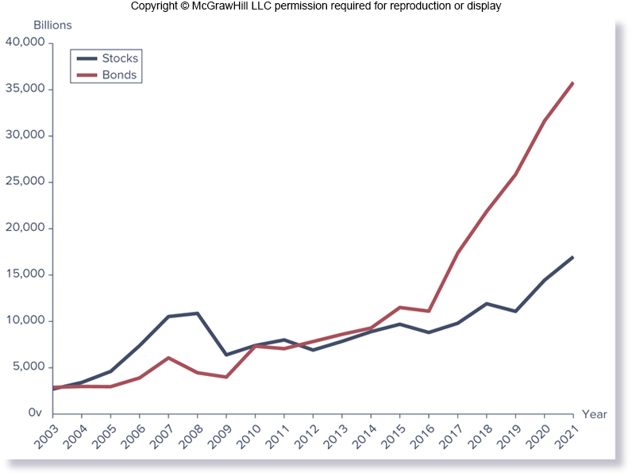
U.S. Transactions in Foreign Securities Markets
Notes:
27
Figures 16–5 shows the U.S. transactions in foreign securities from 2003 to 2021.

Slide 28
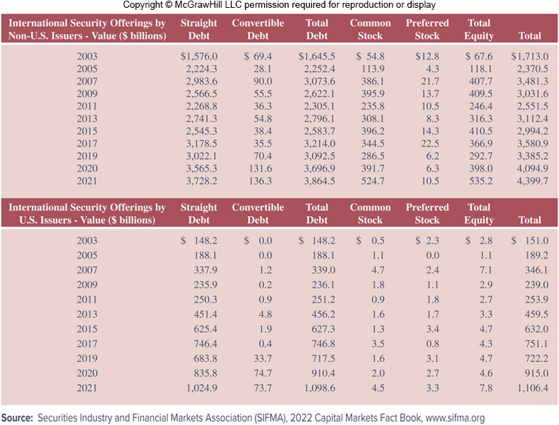
Value of International Security Offerings (in billions of dollars)
Notes:
28
Table 16–8 reports the total dollar value of international security offerings from 2003 to 2021. Over this period, international securities offerings by non-US issuers increased from $1,713.0 billion in 2003 to $3,481.3 billion in 2007, and then decreased during the financial crisis to $3,031.6 billion. The recovery was slow, as new issues didn’t reach 2007 levels until 2017. By 2021, total value of international security offerings by non-US issues stood at 4,399.7 billion. The recovery among U.S. security issuers following the crisis was quicker, surpassing 2007 level by 2013. At the end of 2021, value of international security offerings by US issuers reached $1,106.4 billion.

